Slide 1
Strategic Operations Center
Weekly Standup 01/26
Asanka Nanayakkara, Cyriac Domini, Daniel Bedich, Shantanu Bhardwaj

Slide 2
Presentation Overview
Problem Statement
Roles and Responsibilities
Tasks Accomplished
Risks
Tasks Planned

Slide 3
Problem Statement
Strategic Operations Center (SOC): Our organization has hundreds of flights that are flown each day. We would like to build an application that is a dashboard of our flights, with ability to identify critical issues. And this tool shall have the ability for the SOC members to communicate among themselves to resolve critical issues. The application shall have the following features
a. Publish/subscribe functionality so that as the data changes, user’s screens are updated immediately.
b. Tracking communication among SOC members and associating communications with key entities
c. Dashboard for flights to identify critical issues
d. Ability to search past communications

Slide 4
Problem Statement
Dashboard
Shows Flight Information
Create Critical Issues Messages
Add/Chose Backup Flights
Accept/Decline Availability of Flight Team Members
Update Information Automatically
Chat
General Chat
Filtered Chat Based on Roles
Search Capabilities
Update Chat Automatically

Slide 5
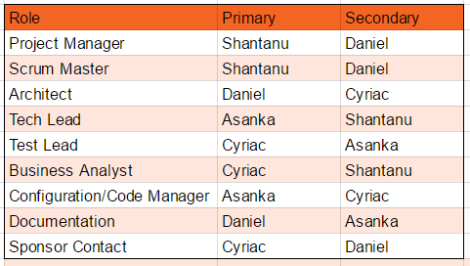
Roles and Responsibilities

Slide 6
Tasks Accomplished
Met With Contact
Went over problem
Looked at existing app
Discussed possible solutions
Looked at different options for the dashboard. Considerations:
CMSs like Joomla
Open source dashboards
Rails based dashboard with a simple front end frameworks like Angular
More concrete general meeting times
Roles set

Slide 7
Risks
Scheduling time to work together
Hard deadline - Not finish in time
Having to reinvent chat app
Choosing the right framework
Learning curve

Slide 8
Tasks Planned
Start making use cases
Start making story cards
Set up sprints
Start making Rails prototype
Find chat app / framework
Continue contacting sponsor

